Slide 1
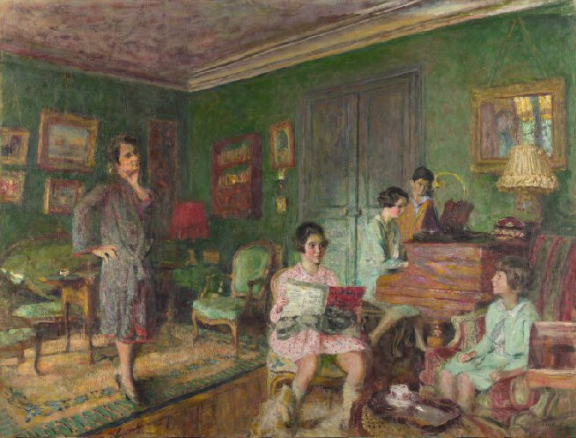
Spring Two: Take One Picture
Year Two Spring Term Two Overview
Welcome back to a term where we will travel back in time and explore famous paintings! Years One and Two will use Edouard Vuillard’s, Madame André Wormser and her Children as inspiration to tell stories using props, focusing on developing their speaking and listening skills. Alongside this, children will listen to music composed at the time of the painting (1920s). This will bring another dimension to the experience; for example using Louis Armstrong and Bessie Smith as inspiration children will experiment with combining sounds to make their own piece of music that voices Vuillard’s piece. To gain a deeper understanding of the painting the children will learn about how portraits were/are created, considering who appears in them and which objects they choose to represent themselves. To support the painting even more, and the theme of the piano, the children will read The Piano Girl which is based on a true story about a girl who loved playing the piano more than anything.
English
Inspiration: Inspiration: Madame André Wormser and her Children 1926/7 by Edouard Vuillard
Programme of study includes: word reading, comprehension, transcription, handwriting, composition and vocabulary, grammar and punctuation.
The process of writing includes: Introduce meaningful opportunity to write, Analysis of text - Read and study genre examples - Talk opportunities - Shared/modelled writing – Planning –Writing - Editing and improving – Publishing
Inspiration:
The Bear and the Piano by David Litchfield
Jack and the Beanstalk, See The Bumper Book of Story Telling, p.40
Jack and the Beanstalk by Roald Dahl, Revolting Rhymes
Jack and the Beanstalk, BFI short animation
During Guided Reading children will explore a variety of books which will inspire discussion and debate.
Class Reading Book: Mr. Big by Ed Vere
Enrichment:
The National Gallery
Art and Design Technology
Art and Design
Artist Study: Edouard Vuillard
Get ready to paint:
To know when to reload paintbrush.
Painting & Colour Skills:
To apply pencil skills: short, long, dots, small circles, dashed, straight, curved, spirals – using a small brush.
Primary colours
Start with one colour – wash dark to light
Block one, even colour
Portraits:
Who, what, where and why?

Slide 2
Take One Picture
Mathematics
Over the year, children will continue to develop their mathematical skills and knowledge through Maths Mastery. Alongside this, the children will apply their maths skills across the curriculum, for example when taking measurements in science they will develop their use of vocabulary to compare and describe measurements and apply this understanding in everyday conversations about their work. When collecting data in science, they will start to learn about statistics and interpret and construct simple charts. During geography lessons, the children will be studying the UK and learning new vocabulary to describe position and direction.
Physical Education
Music
French
Netball and creative dance:
to develop control and coordination of their physical movements
to devise and use repeat compositions and sequences in physical activities
to use and apply simple tactics and strategies
to improve performance by observation and use criteria for evaluation
about the benefits of regular exercise and how their bodies feel when they exercise
Exploring sounds and beat
Compose a short piece of music
to listen with concentration and understanding to a range of high-quality live and recorded music
to experiment with, create, select and combine sounds using the inter-related dimensions of music
Weekly playlists played during assemblies, lunch and breaks. Music used to introduce books/art/topics.
Songs, games and rhymes – counting, animals and colours
Social, Moral and Cultural Education – including Religious Education and RRS
SMSC is embedded in what we do and who we are everyday.
RRS: 38
Science
Computing
Learning Objectives:
Light and Sound (additional unit)
Scientific Enquiry Skills
Ask simple questions, and recognise that they can be answered in different ways
Observe closely, using simple equipment
Perform simple tests
Identify and classify
Use observations and ideas to suggest answers to questions
Gather and record data to help in answering questions.
Google Drive, emailing and document sharing
to use technology safely and respectfully, keeping personal information private
to identify where to go for help and support when they have concerns about content or contact on the internet or other online technologies

