Slide 1
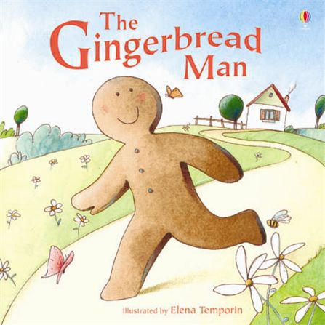
Spring One: London and Beyond
Nursery: Spring One Overview
The classic story ‘The Gingerbread Man’ is acted out this half term so that the children can think about how to stay safe. Their speaking and listening skills will be further developed through innovation of the story and role play activities. Children will have a chance to become bakers and make their own gingerbread and the role play area will be transformed into the Nursery bakery.
Communication and Language
Physical Development
Personal, Social and Emotional Development including RRS
Story Telling
Actions
Role Play
Film – story telling
Exploring different types of movement.
Movement to music.
How does the Gingerbread Man feel?
How to be a good friend to the Gingerbread man
Keeping safe.
Is the fox being a good friend?
Exploring Media and Materials
Understanding the World
Props for storytelling – making a forest, a river, a cave etc.
Sensory storytelling – walking over sand, water, mud etc. – textures
Literacy
Role play of working in a bakery.
Environments – similarities and differences e.g. bakery/river/forest.
Can children write their own instructions and recipes?
Can children think about the speech of the characters in the story?
Other Core Texts:
Biscuit Bear
Mathematics
Over the year, children will continue to develop their mathematical skills and knowledge through Maths Mastery. Alongside this, the children will apply their maths skills across the curriculum, for example thinking about quantity when baking.

