Slide 1
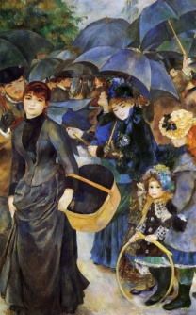
Spring Two: Take One Picture
Nursery Spring Term Two Overview
Welcome back to a half term where we will travel back in time and explore famous paintings! Early Years will use Renoir’s ‘The Umbrellas’ as inspiration to tell stories using props, focusing on developing their speaking and listening skills. Alongside this, children will listen to classical music composed at the time of the painting. This will bring another dimension to the experience. To gain a deeper understanding of the painting the children will learn about the life children in this period including toys and games. We will also explore materials with links to umbrellas and baskets and observe the weather and differences across seasons and locations.
Communication and Language
Physical Development
Personal, Social and Emotional Development including RRS
Storytelling (Rosie’s Walk)
Storytelling area - Baskets for props
Creative dance – link to water/weather theme
Dressing appropriately for the weather
How do we dress for different weathers?
How does the weather make us feel?
How do we share toys? Turn taking.
Exploring Media and Materials
Understanding the World
Exploring materials – umbrellas, baskets, toys.
Basket weaving
Sculptures with umbrellas
Literacy
Toys and games in different periods
Weather
Shopping
Hot seating characters in the picture
What happens next?
Speech/thought bubbles – what are they saying/thinking?
Who is the little girl? Writing a biography.
Stories –Rosie’s Walk
Other Core Texts:
Rosie’s Walk
Tanka, Tanka, Skunk
Mathematics
Over the year, children will explore maths around them using physical objects and by playing interactive games. Everyday they will sing songs and rhymes to help them learn the days of the week and the months of the year.
Collecting and recording data on the weather
Measuring umbrella handle sizes

