Slide 1
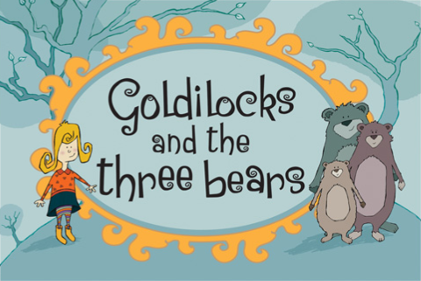
Summer One: Eureka!
Nursery: Summer One Overview
Welcome back to a new term where we will be learning the favourite children’s story ‘Goldilocks and the Three Bears’. By this stage in the year, children will be confident in writing and drawing pieces of work inspired by the story, characters and the class innovation. The children will have a chance to experience the Three Bears house in the role play area and act out the story.
Communication and Language
Physical Development
Personal, Social and Emotional Development including RRS
Story Telling
Actions
Role Play
Film – story telling
Moving in a range of different ways.
Can you move like a big bear etc.?
Feelings – stealing.
How would you feel if someone was in your house and took your things?
Exploring Media and Materials
Junk model buildings for storytelling area.
Build new chair for baby bear– DT
Puppets for storytelling.
Understanding the World
Literacy
Comparison of environments.
Animals – similarities and differences.
Bears- where they live? Eat etc.?
What happened next?
Innovating the story.
What did the bears say…?
My favourite part of the story is…
Other Core Texts:
Aaaarrrgghh Spider!
Mathematics
Over the year, children will continue to develop their mathematical skills and knowledge through Maths Mastery. Alongside this, the children will apply their maths skills across the curriculum, for example comparing the size the chairs/ bowls/ beds.

