Slide 1
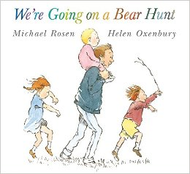
Spring One: London and Beyond
Reception: Spring One Overview
The classic story ‘We’re Going on Bear Hunt’ is acted out this half term so that children can investigate environments and learn about bears. Children will explore feelings and map work, relating locations to one another and finding similarities and differences. Their speaking and listening skills will be further developed through innovation of the story and role play activities.
Communication and Language
Physical Development
Personal, Social and Emotional Development including RRS
Story Telling
Actions
Role Play
Film – story telling
Dance – visiting teacher.
How does the bear feel?
How to be a good friend to the bear.
Keeping safe.
Exploring Media and Materials
Understanding the World
Props for storytelling – making a forest, a river, a cave etc.
Sensory storytelling – walking over sand, water, mud etc. – textures.
Literacy
Bears – finding out information about different types of bear.
Environments – similarities and differences e.g. river/forest/cave.
Map work – make a map of the bear hunt journey.
Write a letter to the bear.
Comparing stories about bears – which is your favourite? Why? Similarities and differences in the stories.
Other Core Texts:
Brown Bear, Brown Bear
Mathematics
Over the year, children will continue to develop their mathematical skills and knowledge through Maths Mastery. Alongside this, the children will apply their maths skills across the curriculum, for example comparing the size of animal homes and comparing weights of fruits.

