Slide 1
Bonjour Year 2.
We’ve been looking at things which live in the sea, and last week I sent you a song about how big things eat smaller things.
I would like you to listen to the song again.
On the next slide are pictures of things which appear in the song. Can you number them in the order they appear.
Then choose from the list of adjectives which one goes with each of the sea creatures. (Clue: there was no adjective for barracuda). Write the adjective and number under the word for the animal.
Then go to slide 3 and follow the instructions about adjectives.

Slide 2
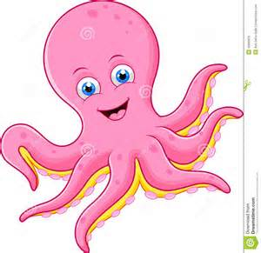
barracuda
pieuvre
?
?
requin
?
baleine
?
petit
belle
grand
grosse
poisson
?

Slide 3
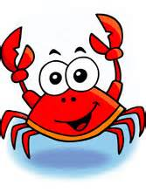
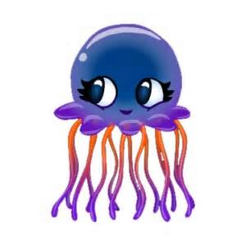
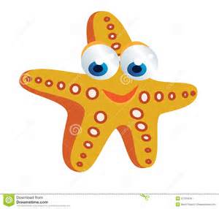
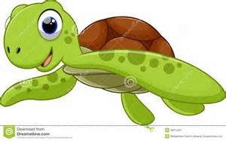
La grosse baleine est bleu.
The big whale is blue
Adjectives for describing sea creatures
Pick one of these adjectives to put in each of the blank spaces in the sentences.
petit = little
belle = beautiful
grand = big
grosse = big/fat
jolie = nice/pretty
bon = good
jeune = young
vieux = old
mechant = naughty
Le ________ crabe est rouge.
La _________ méduse est…..
La ____________ étoile de mer est …
Le _______________ hippocampe est …
La ____________ tortue est …

